Slide 1
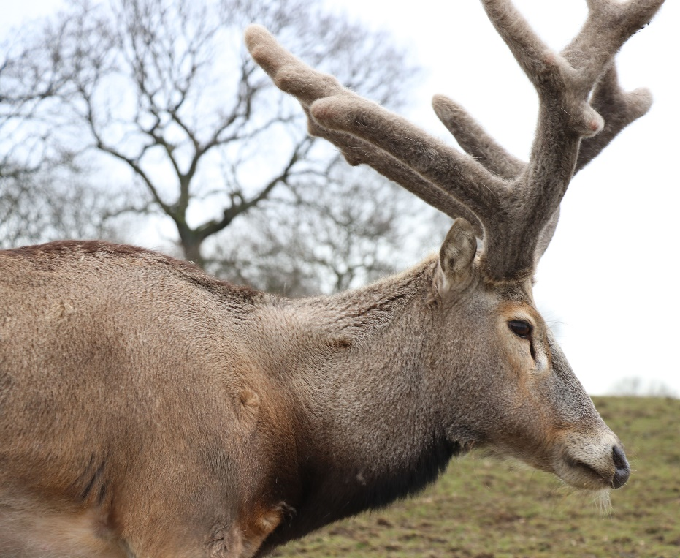
Tick ____ below each animal when you spot them on the safari drive!
Safari Drive
Spot the
Animal!
Bactrian Camel
______
Eastern Kiang
______
Name …………………..
Père David’s Deer
______
Yak
______

Slide 2
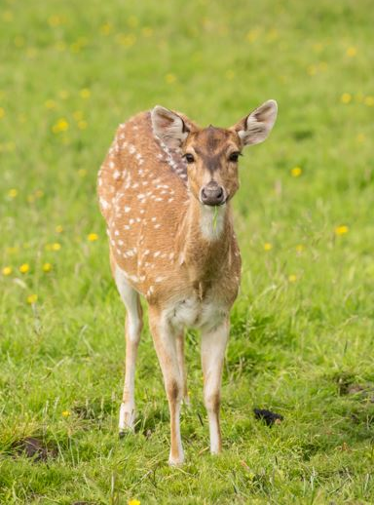
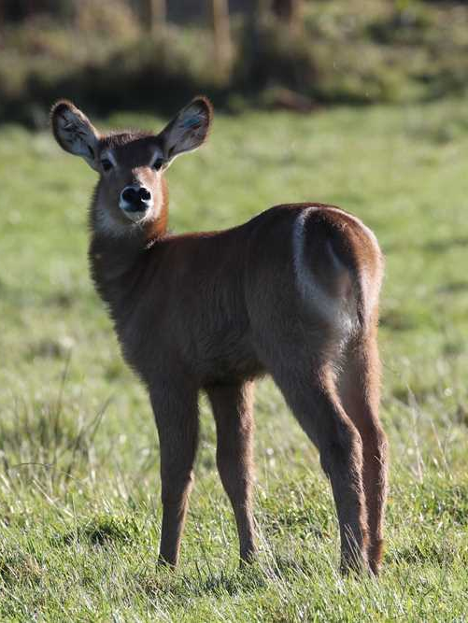
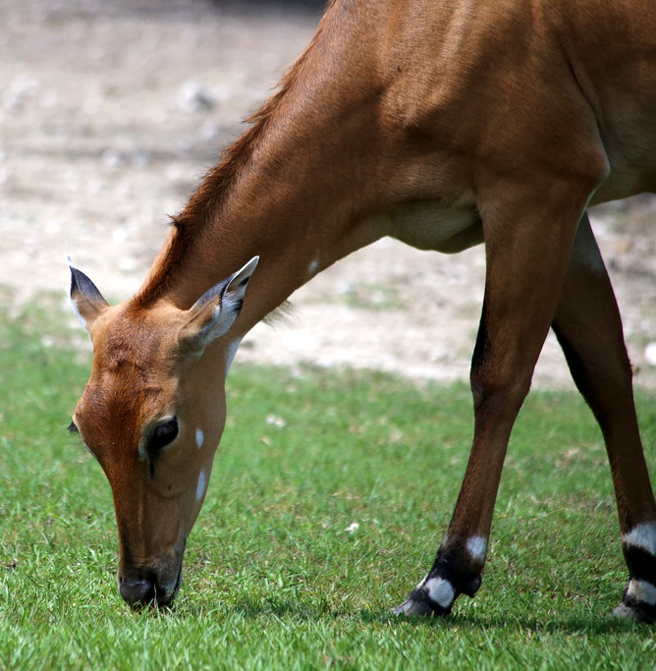
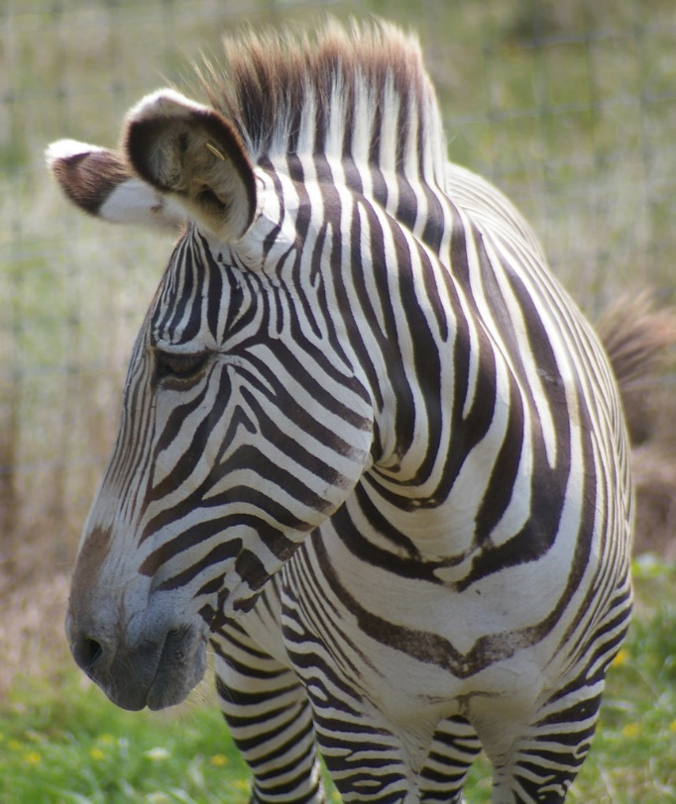
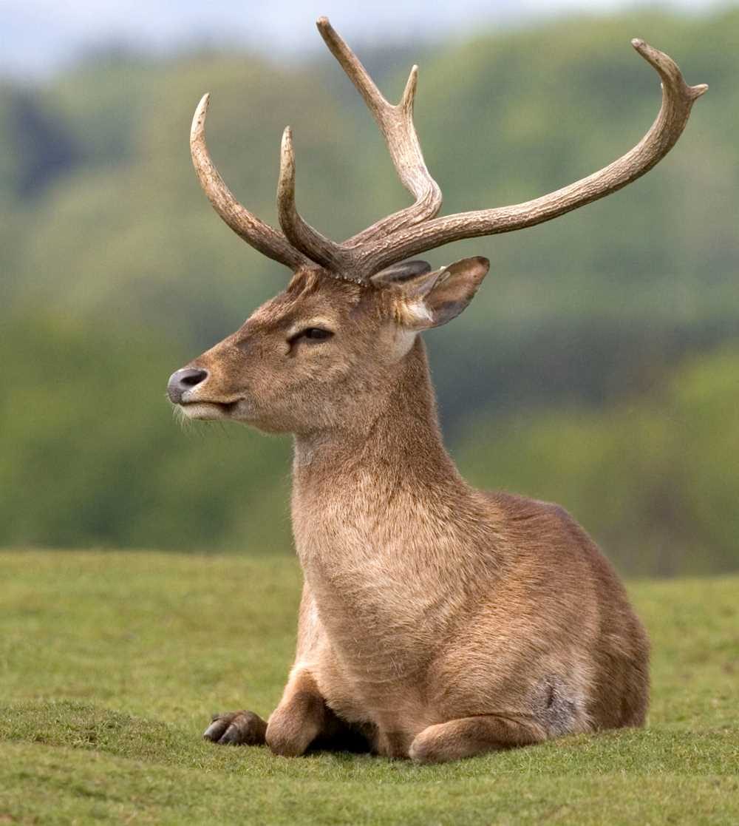
Axis Deer
_____
Nilgai
_____
Zebra
_____
Waterbuck
_____
Eld’s Deer
_____
Blackbuck
_____
Southern White
Rhino
_____
Wildebeest
_____

Slide 3
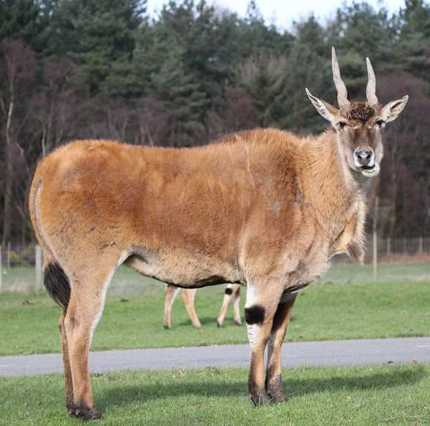
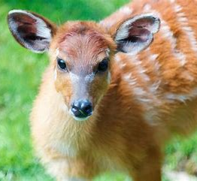
Forest Buffalo
_____
Bongo
_____
Common Eland
_____
Roan
_____
Sitatunga
_____
Ostrich
_____
Baboon
_____
Red Lechwe
_____

Slide 4
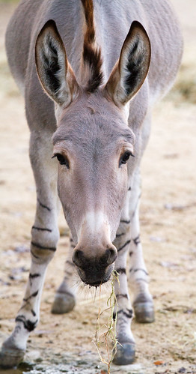
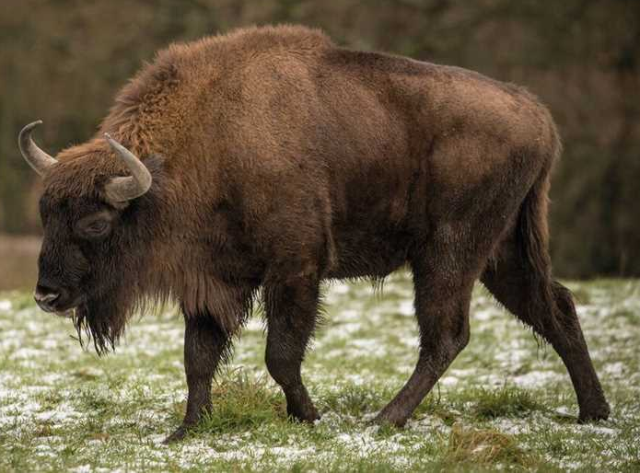
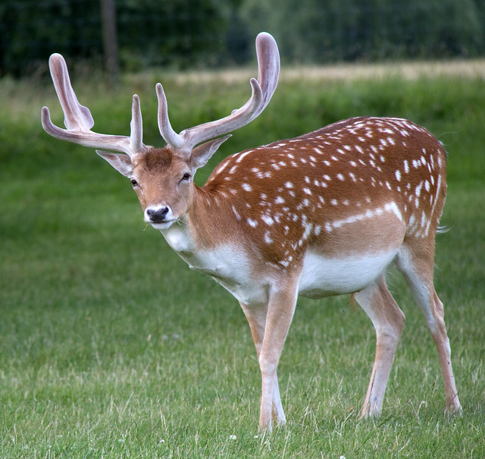
Iberian Wolf
_____
Moose
_____
European Bison
_____
Somali Wild Ass
_____
Well Done!
Don’t worry if you didn’t spot all the animals… Hopefully you will next time!
Fallow deer
_____
Lion
_____

