Slide 1
Is a Habitat a place an animal lives?
TRUE or FALSE
What 3 things does a Habitat need?
WATER GAMES FOOD
SHELTER BLANKETS
Camouflage is when an animal blends
in with its background?
TRUE or FALSE
Hidden Habitats
Pre
Activity
Name ……………...…….

Slide 2
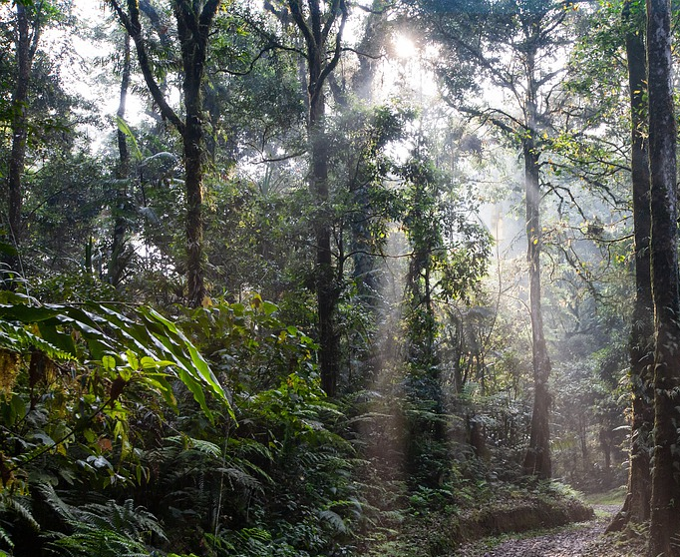
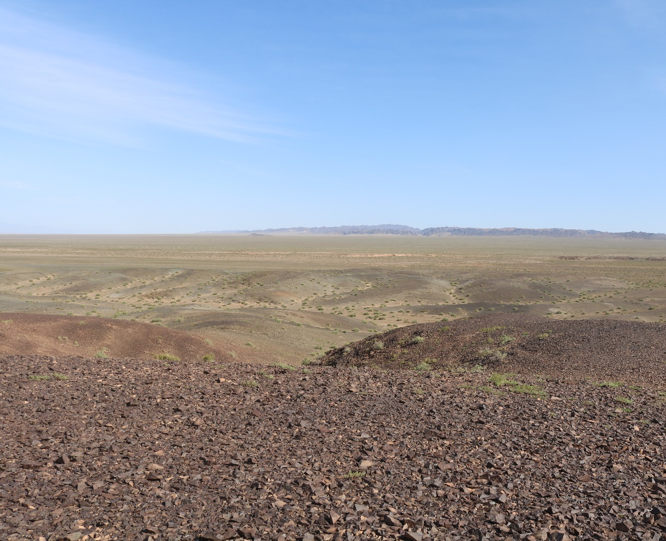
Colour the animals below to camouflage and blend in with its Habitat

Slide 3
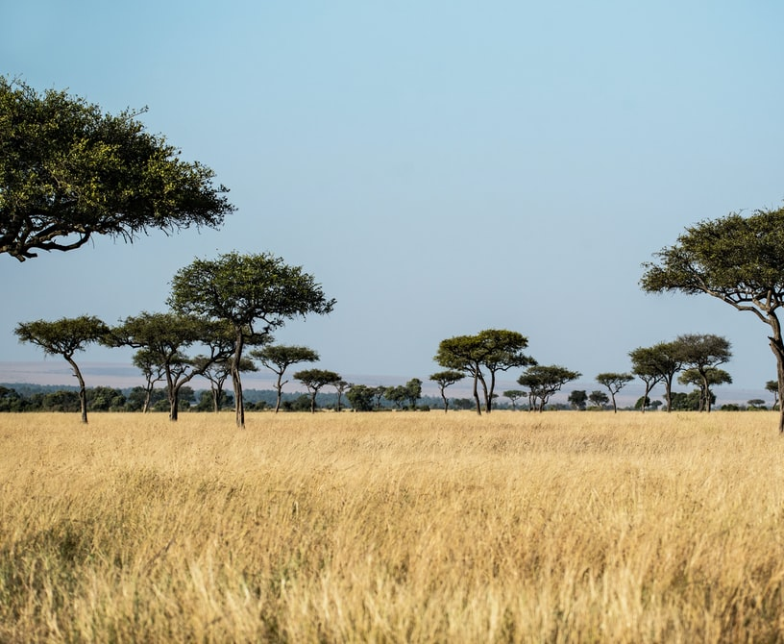
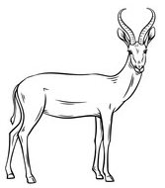
Teachers Answers
Is a Habitat a place an animal lives?
TRUE or FALSE
What 3 things does a Habitat need?
WATER GAMES FOOD
SHELTER BLANKETS
Camouflage is when an animal blends
in with its background?
TRUE or FALSE

