Slide 1
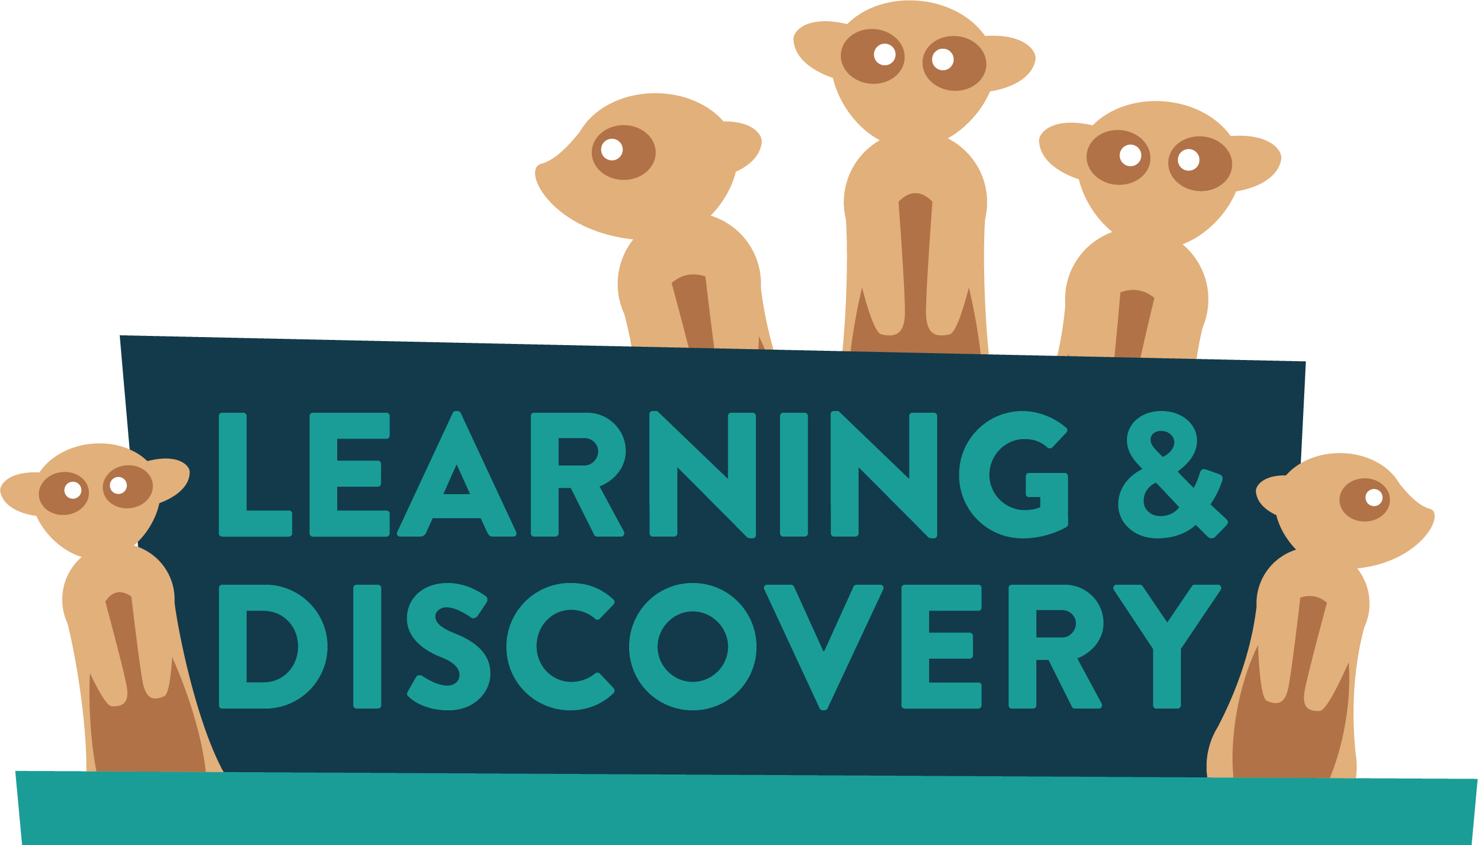
Some animals are classed as endangered, what does that mean? …………………………………..………………………………………………………………………………………………………………..……………………………………………….
Can you think of the word for if there are none left at all?
E ……………………….
Conservation
Champions
Pre
Activity
Name ……………...…….

Slide 2
Some animals died out a long time ago, can you find them in the word search below?
Dinosaurs , Woolly Mammoth, Dodo, Tasmanian Tiger, Irish Elk
Javan Tiger, Golden Toad, Paradise Parrot, Quagga
Sabre Tooth Cat
IUCN Red List
When the numbers of animals left in the wild gets very low, they are classed as endangered. There are also other words that we use to describe how many animals are left in the wild. Can you try and guess where you may put them on the scale?
Extinct - EX
VULNERABLE - VU
NEAR THREATENED - NT
EXTINCT IN THE WILD - EW
ENDANGERED - EN
CRITICALLY ENDANGERED - CR
LEAST CONCERN - LC
EX

Slide 3
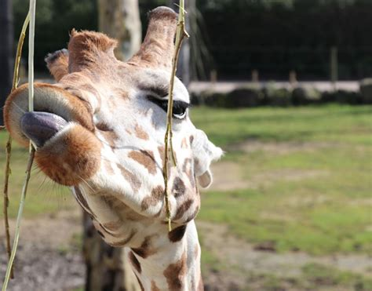
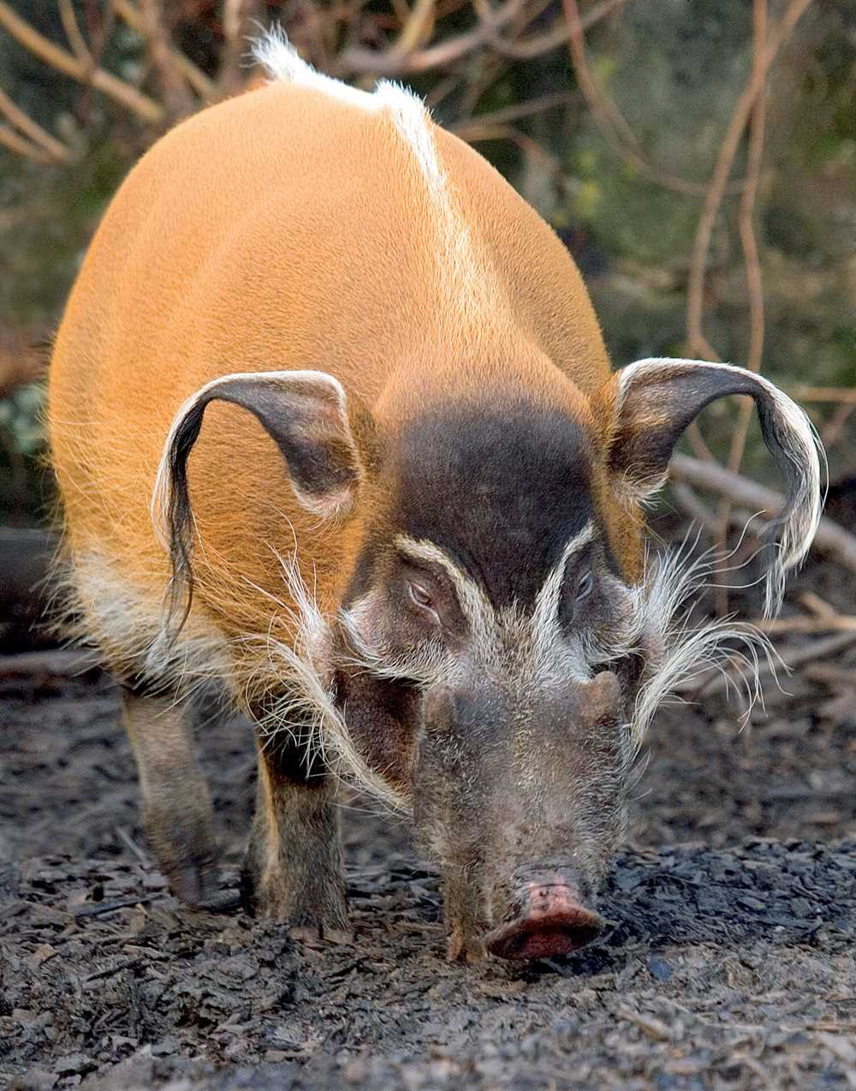
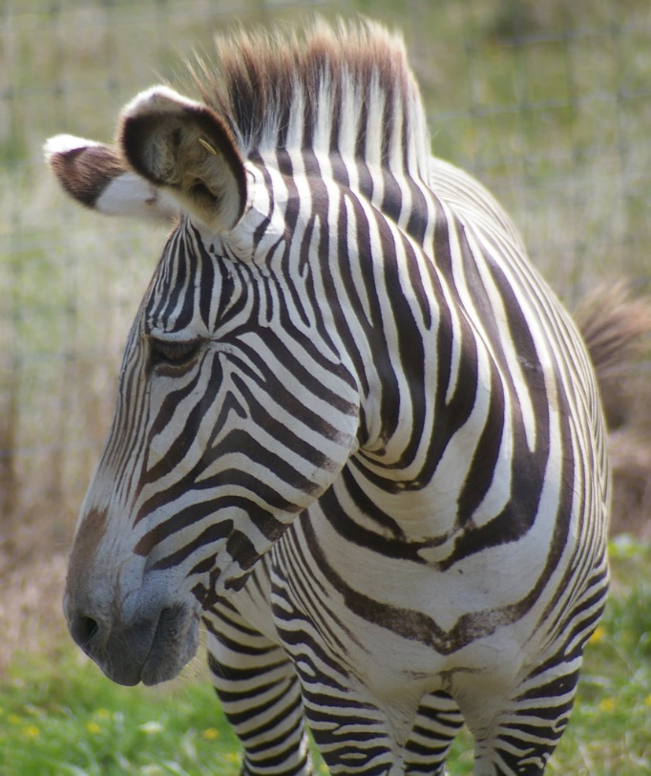
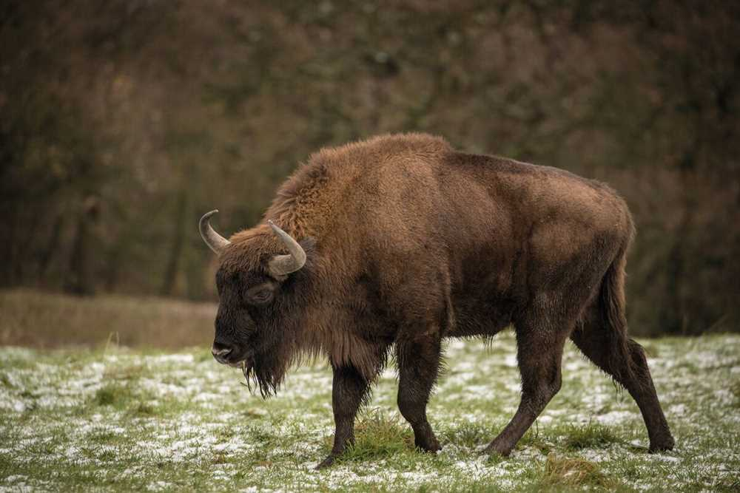
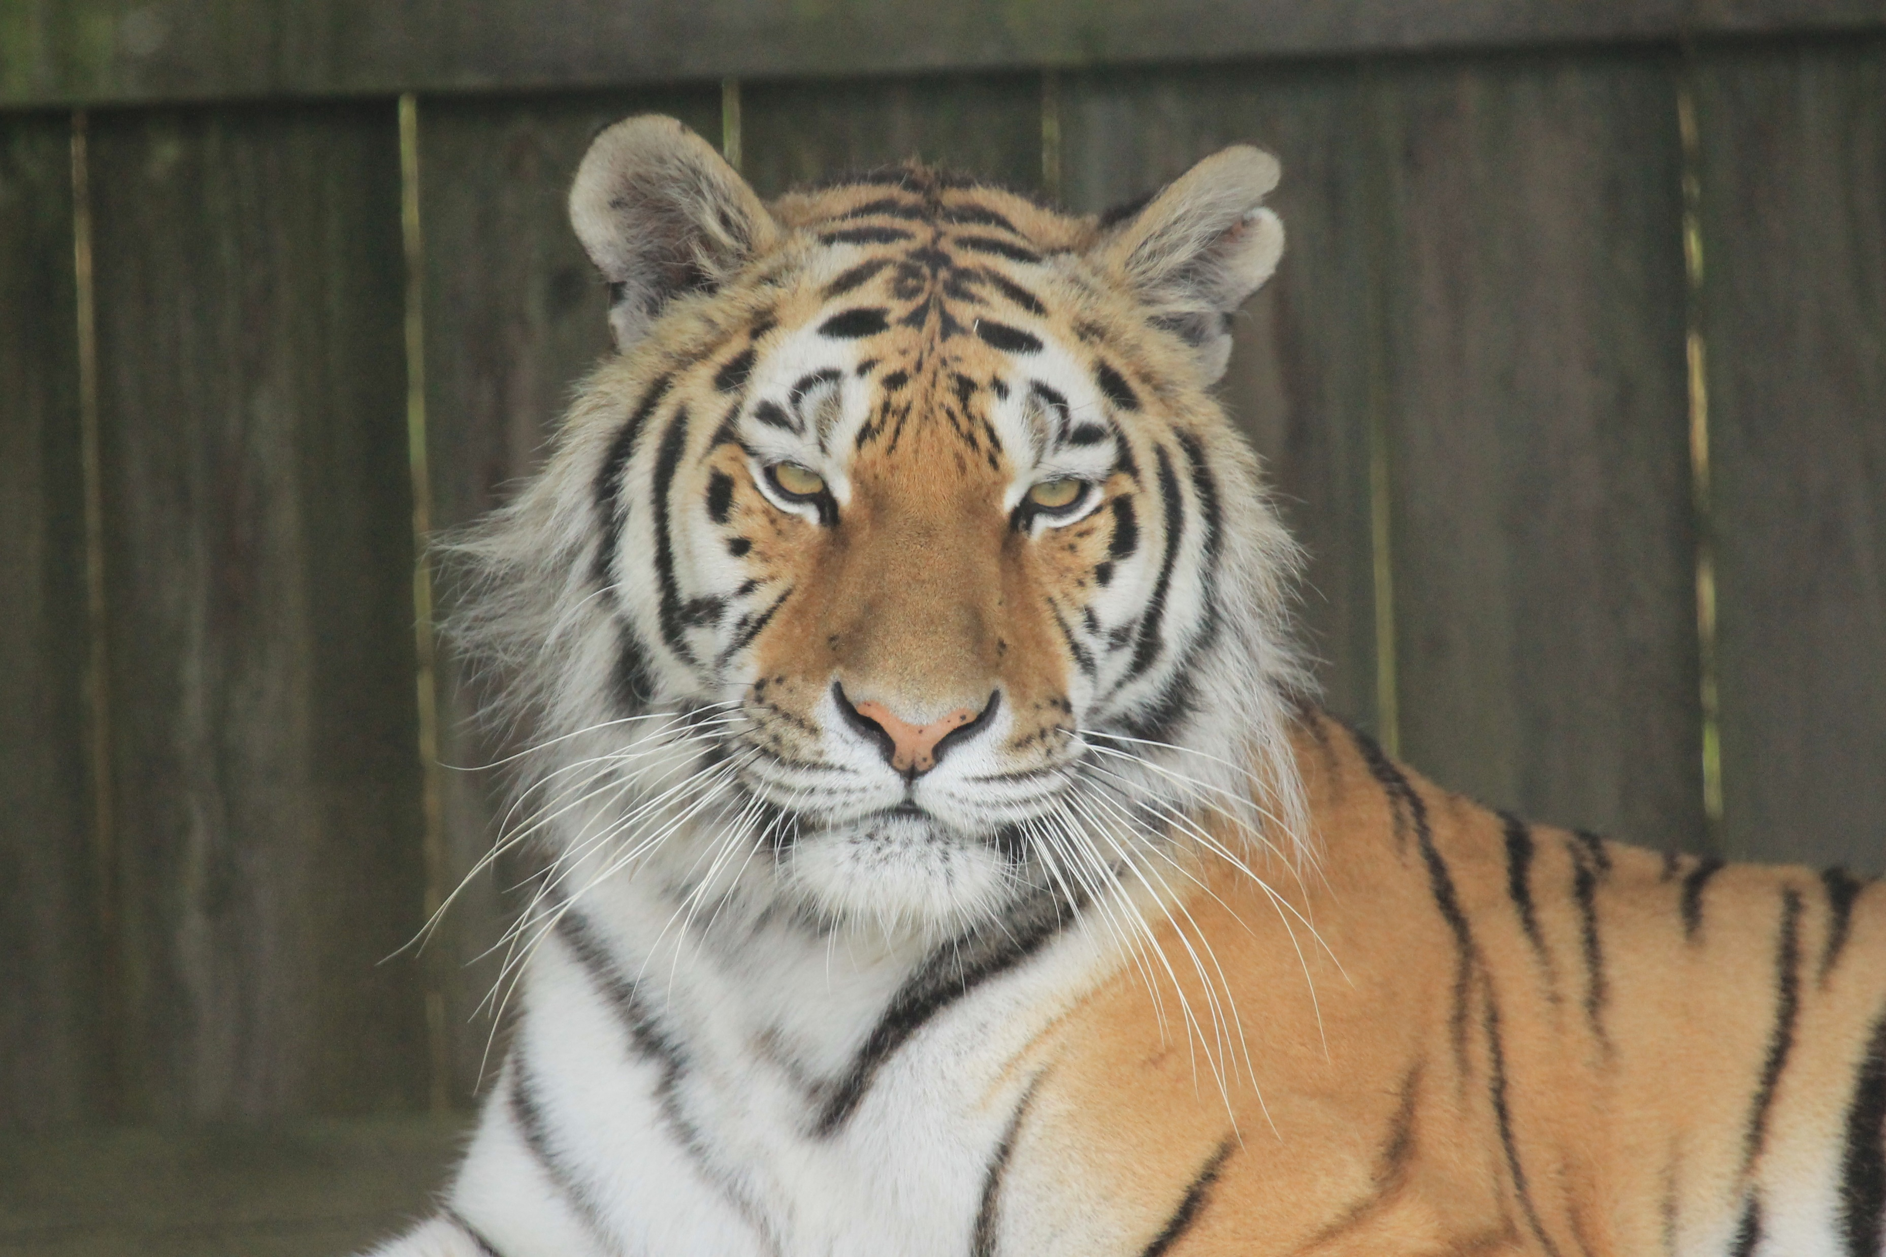
Tigers all have lovely stripe patterns that help them camouflage. They are also a great way for us to be able to tell tigers apart from each other because all tigers have different patterns. They are like our fingerprints.
In the space below draw what a tiger's stripe pattern may look like…
Below are some of the animals we have at the safari. Circles the ones you think are classed as Least Concern (LC) on the IUCN red list

Slide 4
Teachers Answers
Some animals are classed as endangered, what does that mean?
Species which have been categorized as very likely to become extinct in their known native ranges in the near future.
Can you think of the word for if there are none left at all?
Extinct
EX
EW
CR
EN
VU
NT
LC

