Slide 1
Meerkat
What is this behaviour called?
_______________________
In the wild, meerkats live in ___________ habitats
African Animal
Foot safari
Fact File
On the IUCN red list, meerkats are classed as __________________________
Birds of Prey are a predator of Meerkats
TRUE or FALSE
Circle all of the food items which are part of a Meerkats diet
BUGS FRUIT EGGS FISH CHICKS
Meerkats live in groups called _________
Name ……………...…….

Slide 2
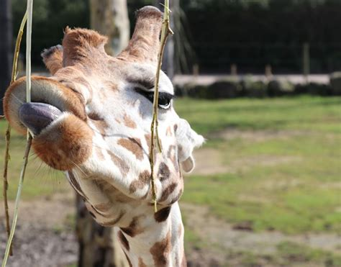
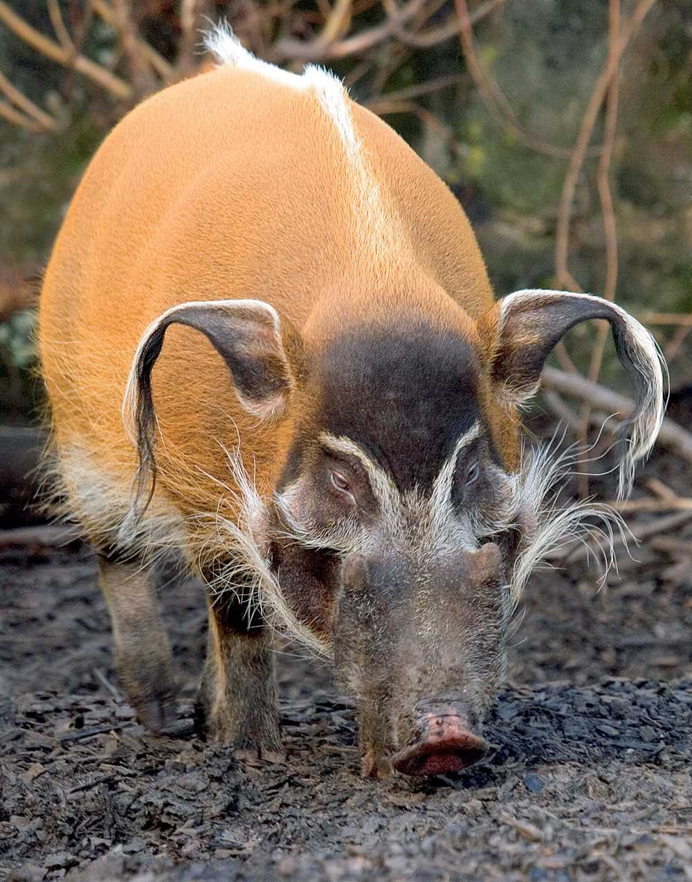
Giraffe
Red River Hog
A giraffe tongue is _________ cm long
Here at Knowsley, we have ____ Red River Hogs
Giraffes drink less water than camels.
TRUE or FALSE
Why is a giraffe’s habitat restricted by water? ______________________________________________________________________________
We have ____ giraffes in our tower.
Giraffe have 7 neck bones, like most mammals.
TRUE of FALSE
Who is bigger, males or females? ________________________
Name 3 foods that Red River Hogs eat 1. _____________________________________ 2. _____________________________________
3. _____________________________________
A group of Red River Hogs is knows as Sounders
TRUE or FALSE
Name 2 reasons why they have long ears 1. ______________________________________ 2. ______________________________________

Slide 3
Giraffe
A giraffe tongue is 45 - 51cm long
Giraffes drink less water than camels.
TRUE or FALSE
Why is a giraffe’s habitat restricted by
water? Because they will sink in wet mud
We have 2 giraffes in our tower.
Giraffe have 7 neck bones,
like most mammals.
TRUE of FALSE
Who is bigger, males or females?
Males
Meerkat
What is this behaviour called?
Sentry Duty
Teachers Answers
In the wild, meerkats live in
Desert habitats
Red River Hog
On the IUCN red list, meerkat
are classed as Least Concern
Birds of Prey are a predator of
Meerkats
TRUE or FALSE
Meerkats live in groups called
Mobs
Circle all of the food items which are
part of a Meerkats diet
BUGS FRUIT EGGS FISH CHICKS
Here at Knowsley, we have 2 Red River Hogs
Name 3 foods that Red River Hogs eat Bugs, small animals, eggs, fruit
and vegetables
A group of Red River Hogs is knows as
Sounders
TRUE or FALSE
Name 2 reasons why they have long ears Fly swatter, to look bigger

